Slide 1
Scholarships
and
Youth

Slide 2


Slide 3
You may think scholarship and youth programs are the same but know we different in several ways.
The Scholarships program includes essays and art for youth as well as adults.
The Youth program includes art and books, but adults' past college must stay in their lane.
So you see we are similar but different, let’s find out more.

Slide 4
The Scholarships program provides opportunity to show patriotism through creative writing and art
The Youth Activities program sponsors and works with many different groups
The Scholarships program promotes Art scholarships for grades 9-12
The Youth program promotes an art contest grades K-8

Slide 5
The Scholarships program promotes Essay scholarships for grades 6-12
The Youth program recognizes youth efforts and projects honoring Veterans
The Scholarships program promotes Continuing Education for Auxiliary members and their immediate family (age 21+)
The Youth program recognizes our youth showing patriotism.

Slide 6
Should we test their knowledge?
You read my mind, let’s give it a try.

Slide 7
Three of these things belong together.
Three of these things are the same program.
One of these things belong to another.
One of these things are another program.

Slide 8
Tell us the letter to the one that does not belong.
We are going to show you four options.

Slide 9
Are you able to find the wrong one?
Let’s start with Scholarships

Slide 10
A. Young American Patriotic Art
B. Patriot’s Pen
C. Illustrating America
D. 3-D Art

Slide 11


Slide 12
See if you are able to find the wrong one?
Let’s try Youth

Slide 13
And you tell us the letter to the one that does not belong.
Again, we are going to show you four options.

Slide 14
A. Illustrating America
B. Voice of Democracy
C. Patriotism through Literacy
D. Random acts of Patriotism (RAP)

Slide 15


Slide 16
Let’s give it another try.
They seem to be on a role.

Slide 17
Will they get this one right?
Scholarships

Slide 18
A. Building the Fund
B. Continuing Education
C. Patriotic Art
D. Random acts of Patriotism (RAP)

Slide 19


Slide 20
Last time, which one does not belong?
Youth

Slide 21
A. Sponsoring school clubs
B. Fostering a love of reading
C. Thanking a veteran
D. Young American Creative Patriotic Art

Slide 23
Did you get them all correct?

Slide 24
Do you see how Scholarship and Youth could work together while being their own program.

Slide 26
Reporting
Let’s talk about reporting
Tell the Story
  How did you raise the money
  How did you promote / educate the community and youth groups / encourage participation
  How did you recognize and/or reward for participation and patriotism
  Details do Matter – doesn’t have to be lengthy
  If you do the same event multiple times, consider reporting quarterly instead of the same repeated report
Donations
  Specify which fund the money went to examples: Patriotic art, continuing education, Illustrating art contest

Slide 27
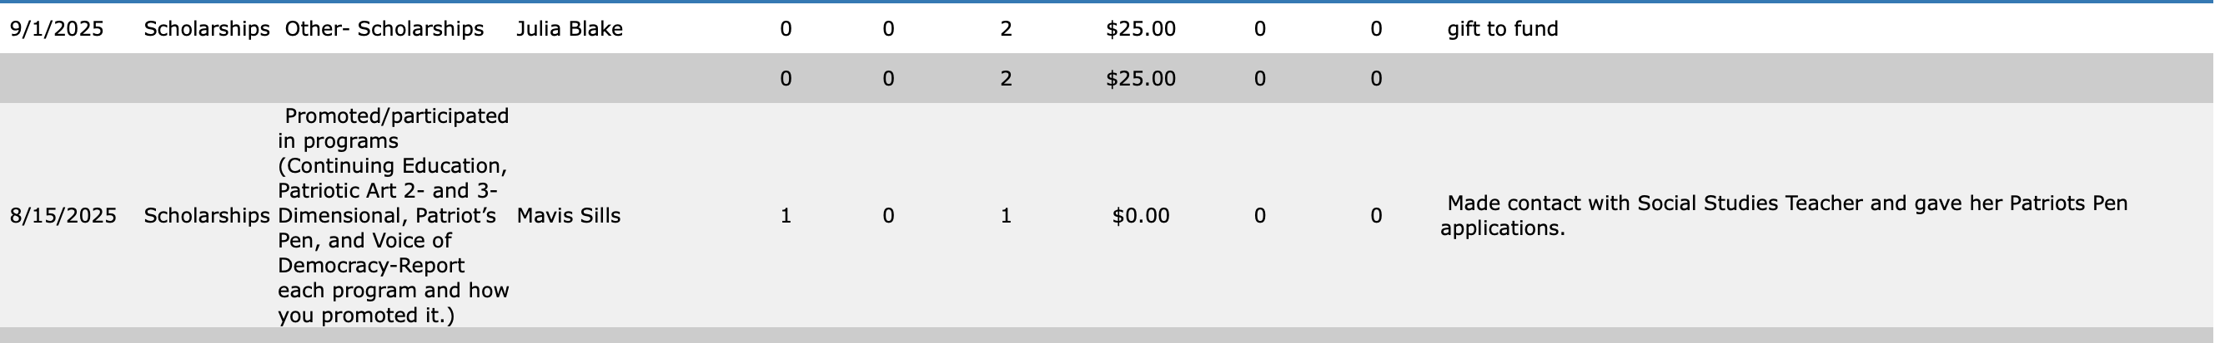
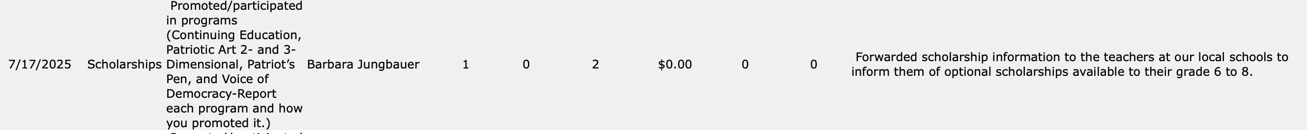

Slide 28
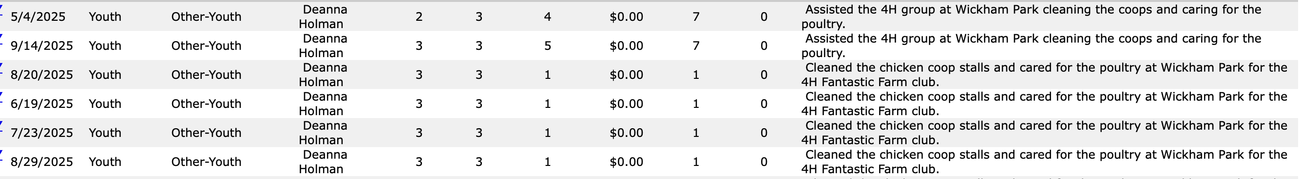

Slide 29

SCHOLARSHIPS
PARTICIPATION
Promote
in
Community
Receive
Entries
Judge / Submit
Recognize
Build the
Fund
CONTINUING EDUCATION
YOUNG AMERICAN PATRIOTIC ART
3-D ART
VOICE OF DEMOCRACY
PATRIOT’S PEN
Carrie Messer
messerca@gmail.com

Slide 30
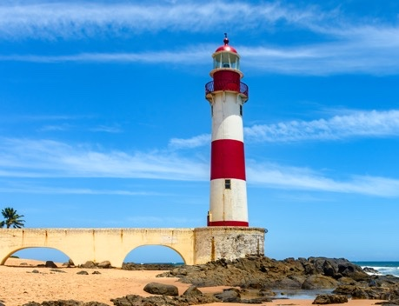
Continuing Education
This one is for US (and our spouse and children age 21 and older)
Deadline – 15 FEBRUARY (to National)
Build the Fund – NPSP
1 selection for each of the four regions
https://vfwauxiliary.org/scholarships/continuing-education/

Slide 31

Young American Patriotic Art TIPS
Flag Etiquette
Paper - reinforced with heavy paper
Entry Form – complete, legible, signed (including the Auxiliary section), with the typed essay.
DEADLINE TO DEPARTMENT CHAIR – 15 APRIL 2026 One entry per Auxiliary.
PACKAGING – Protect these priceless masterpieces
Size – 8x10 up to 18x24 including mat
Canvas - stretcher frame or canvas board
Grades: 9-12

Slide 32
3D Art
TIPS
Grades: 9-12
Size - no larger than 18"
Weight – no heavier than 5 lbs
At least TWO photos
Entry Form – complete, legible, signed (including the Auxiliary section), with the typed essay
DEADLINE TO DEPARTMENT CHAIR –
15 APRIL 2026. One entry per Auxiliary.
PACKAGING – Protect these priceless masterpieces

Slide 33
Voice of Democracy Grades 9-12
Patriot’s Pen Grades 6-8
Promote All year
Work with your Post
Deadlines:
  To Post – 31 October
  To District – 15 November
  To Department – 15 December
Follow Chairman’s Manual

Slide 34
Auxiliary Awards
DEADLINE TO DEPARTMENT CHAIR:
31 MARCH 2026

Slide 35
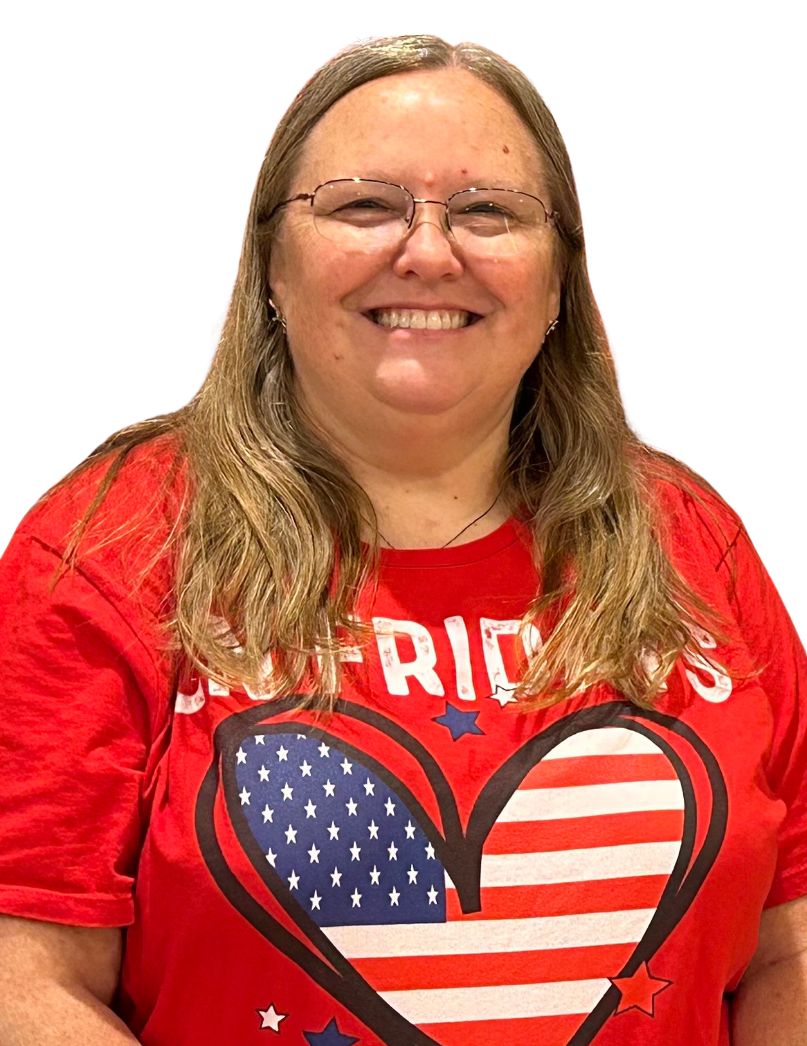
Youth
Sponsor and work with local groups
Faith-based youth groups
After-school programs
School clubs
Home-school associations
Youth sports teams
Promote Illustrating America Art Contest
Promote Patriotism through Literacy
Recognizing Random acts of Patriotism
Recognizes youth and youth groups for their efforts and service projects honoring veterans, service members and their families.
Lanaie Reed
lanwileth@gmail.com

Slide 36
Illustrating America Art Contest
Grades: K-8
March 31: Student entries due to sponsoring VFW Auxiliary
Entries may not be smaller than 8”X10” and no larger than 18”X24”
April 15: Entries due to Youth Department Chairman

Slide 37
Auxiliary Youth
Awards
DEADLINE TO DEPARTMENT CHAIR:
31 MARCH 2026

Slide 38

From Sea to shining Sea
Honoring Veterans who keep us free
Building On the VFW Auxiliary Foundation

Slide 39
Thank you

